Slide 1


Owen Hargrove
5/28/2023

Slide 2

Outline
Executive Summary – Slide 5
Introduction – Slide 4
Methodology – Slide 6
Results – Slide 7
Conclusion – Slide 45
Appendix – Slide 46

Slide 3
Executive Summary
Summary of methodologies
Summary of all results

Slide 4
Introduction
In this project We looked into the data behind all of Space X's launches to look for viable and important data around whether their missions were a success or not. This was with the goal of helping our own company Space Y to succeed and to find the best ways to launch rockets with the most success. We looked into questions of whether things like payload mass and launch location had effects on rocket success along with other things and were able to draw conclusions on what variables were best to allow the best success rate of missions.

Slide 5

Section 1

Slide 6
Methodology
Executive Summary
Data collection methodology:
Data was collected from 2 sources one from the SpaceX API and the other using webscrapping to get important data off of Wikipedia.
Perform data wrangling
The data was then processed into pandas data frames that were modified and changed to allow for better understandability and to allow for better visualization latter on
Perform exploratory data analysis (EDA) using visualization and SQL
Perform interactive visual analytics using Folium and Plotly Dash
Perform predictive analysis using classification models
We then after visualization and testing of models found that a Logarithmic regression model would yield the best out of sample results returning a test accuracy of around 83%

Slide 7
Data Collection
Describe how data sets were collected.
We used the SPACEXAPI to collect an majority of the data right from Space X who kept data on their launches then we used webscraping to collect extra important data from Wikapidia.
SPACEXAPI
PandasDF
Final Data Set
Wikipidia
PandasDF

Slide 8
Data Collection – SpaceX API
SpaceX Data
DataScienceCapstone/jupyter-labs-spacex-data-collection-api (1).ipynb at main · ojhargrove21/DataScienceCapstone (github.com)
Get needed parameters
Rename
Parmeters
Get only Falcon 9
Replace None in Payload mass with mean

Slide 9
Data Collection - Scraping
Wikipidia
Save DF to csv
DataScienceCapstone/jupyter-labs-webscraping.ipynb at main · ojhargrove21/DataScienceCapstone (github.com)
Find all tables
Save to Pandas Df
Select table with the info needed
Create Dictionary with table headers and values

Slide 10
Data Wrangling
Here we used a variety of tools to find out things about the data like launches in a certain orbit and launches from specific sites this was then able to be used to better inform us for latter steps
DataScienceCapstone/IBM-DS0321EN-SkillsNetwork_labs_module_1_L3_labs-jupyter-spacex-data_wrangling_jupyterlite.jupyterlite.ipynb at main · ojhargrove21/DataScienceCapstone · GitHub
Find number of launches per site
Find number of launches per orbit
Find number of success and failure per orbit
Add landing outcome column to Pandas DF

Slide 11
EDA with Data Visualization
The plots we made were a scatter plot comparing Payload mass to flight number, a scatter plot comparing flight number to launch site, a scatterplot comparing payload mass to launch site, a bar chart that showed success rate at each launch site, a scatter plot comparing orbit to flight number, a scatter plot comparing payload mass to orbit, and a line plot comparing date to success rate. These graphs allowed us to visualize the success rate and to decide on what algorithm would be best to use
DataScienceCapstone/IBM-DS0321EN-SkillsNetwork_labs_module_2_jupyter-labs-eda-dataviz.ipynb.jupyterlite (1).ipynb at main · ojhargrove21/DataScienceCapstone (github.com)

Slide 12
EDA with SQL
Listed all Launch sites
Displayed first 5 sites starting with CCA
Sumed the payload mass where the customer was NASA
Sumed the payload mass from the f9 1.1 booster
Found first success landing on ground pad date
Found number of success and failure
Listed different versions of booster
DataScienceCapstone/jupyter-labs-eda-sql-coursera_sqllite.ipynb at main · ojhargrove21/DataScienceCapstone (github.com)

Slide 13
Build an Interactive Map with Folium
We created maps showing the different launch sites and where the success and failed launches occurred we also measured the distances to important features like the ocean and highways to see if this had an effect of success rate.
DataScienceCapstone/IBM-DS0321EN-SkillsNetwork_labs_module_3_lab_jupyter_launch_site_location.jupyterlite.ipynb at main · ojhargrove21/DataScienceCapstone (github.com)

Slide 14
Build a Dashboard with Plotly Dash
Used pie charts and scatter plots to show the success rates at launch sites and locations. This was so that people could easily look and compare success rates based on different important factors that were in the dataset
DataScienceCapstone/spacex_dash_app.py at main · ojhargrove21/DataScienceCapstone (github.com)

Slide 15
Predictive Analysis (Classification)
First we started by fitting 4 models to the data Logerithmic Regression, SVM, Tree Regresion, and KKN. We the found their training and test accuracy and compared them to find that they were all about equal exept for the tree regression which was noticeably lower that the other so we oppted to use Log Regression
.
DataScienceCapstone/IBM-DS0321EN-SkillsNetwork_labs_module_4_SpaceX_Machine_Learning_Prediction_Part_5.jupyterlite.ipynb at main · ojhargrove21/DataScienceCapstone (github.com)
Make different models
Find training and test accuracy
Compare models
Select model

Slide 16

Section 2

Slide 17
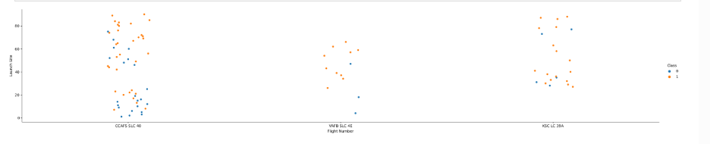
Flight Number vs. Launch Site
This graph shows the flight number compared to the launch site. We can see that while the other 2 sites continue after about flight 60 VAFB SLC 4E stops. This could potentially have an effect on conclusions we are able to draw about the data as it could be scuewed.

Slide 18
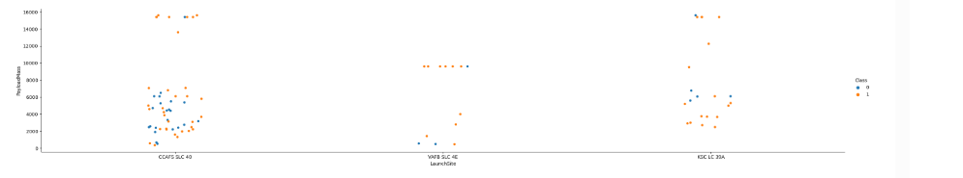
Payload vs. Launch Site
This graph shows the Payload verse the Launch site and also shows that the first 2 have gaps in their data where certain payloads were never launched from these sites possibly effecting any conclusions we could draw about payload data and launch site success.

Slide 19
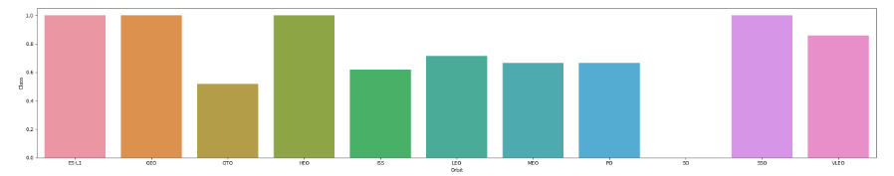
Success Rate vs. Orbit Type
This chart shows the success rates at different orbits we can see that some of these orbits has less success that others which could help us draw conclusions about them others have no success rate suggesting that no lauches were made to that orbit or none were sucessful.

Slide 20
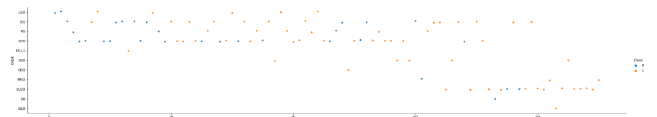
Flight Number vs. Orbit Type
This graph shows flight numbers compared to orbit type and shows that over time the orbits that were launched into changed helping us to draw conclusions about the success of these missions and allowing us to understand why success might have changed.

Slide 21
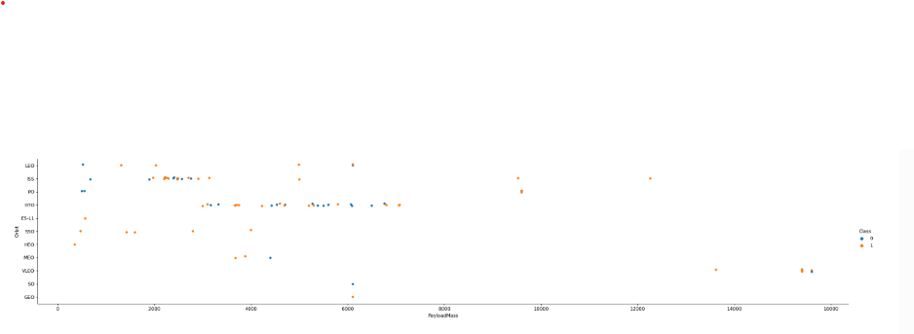
Payload vs. Orbit Type
This Plot shows Payload vs. Orbit type and allows us to see the success and failures of different payloads at different orbits helping us to better understand the data and why a mission either succeeds or fails

Slide 22
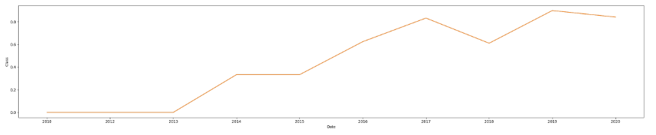
Launch Success Yearly Trend
This plot show success rate and how it compars to the date it shows that as time has past success has increased this allows us to tie in all of our data to make predictions and conclusions on why this might be and what SpaceX did to achieve this success.

Slide 23
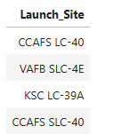
All Launch Site Names
This shows a list of all launch sites produced by the sql querry

Slide 24
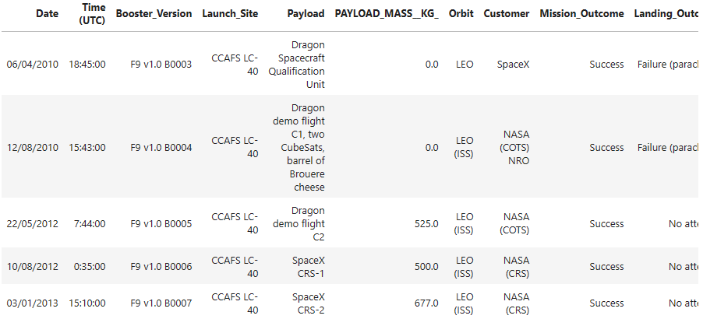
Launch Site Names Begin with 'CCA'
This shows first 5 queries starting with CCA that were produced by the sql querry

Slide 25
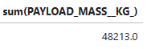
Total Payload Mass
This shows the total payload mass for NASA produced by the SQL querry

Slide 26
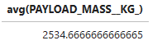
Average Payload Mass by F9 v1.1
This shows the average payload mass carried by the F9 v1.1 booster produced by the SQL querry

Slide 27
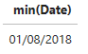
First Successful Ground Landing Date
This shows first successful ground landing date produced by SQL querry

Slide 28
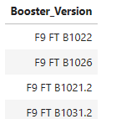
Successful Drone Ship Landing with Payload between 4000 and 6000
This shows the names of all the boosters who have landed on a drone ship with payload between 4000 and 6000 produced by SQL querry

Slide 29
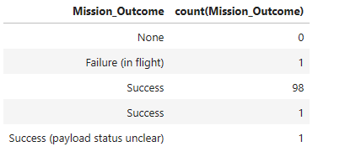
Total Number of Successful and Failure Mission Outcomes
This shows the failures and success and what type they are produced by the SQL querry

Slide 30
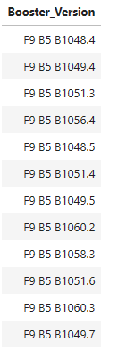
Boosters Carried Maximum Payload
This shows the names of the boosters that carried the max payload produced by the SQL querry

Slide 31
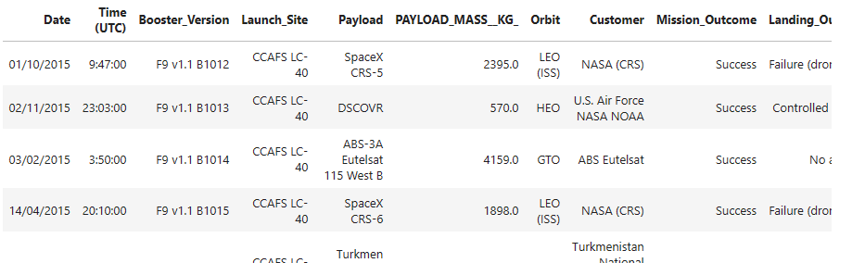
2015 Launch Records
This shows the 2015 launch records produced by the sql querry

Slide 32
Rank Landing Outcomes Between 2010-06-04 and 2017-03-20
Rank the count of landing outcomes (such as Failure (drone ship) or Success (ground pad)) between the date 2010-06-04 and 2017-03-20, in descending order
Present your query result with a short explanation here

Slide 33

Section 3

Slide 34
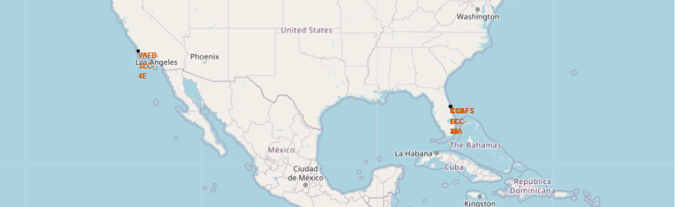
Folium Map Site Locations
Shows the Launch sites used by SpaceX

Slide 35
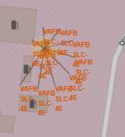
Folium Map Success and Failures
Shows the different launch locations in launch site and success

Slide 36
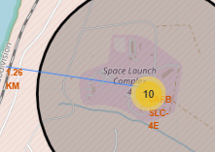
Folium Map Distance from Features
Shows distance between coat and launch site to use in analysis

Slide 37

Section 4

Slide 38
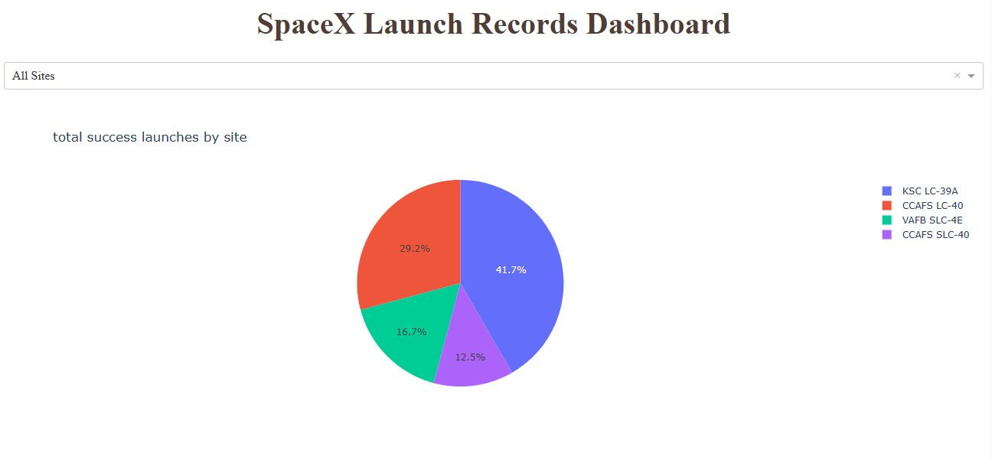
All Sites Pie chart
Shows the percent of successes that came from each different launch site

Slide 39
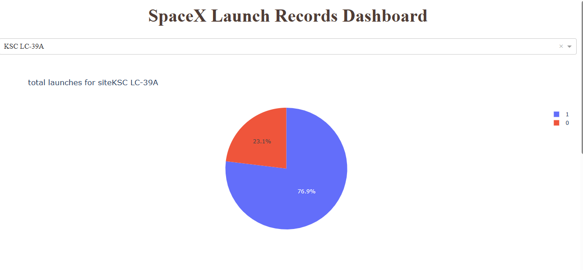
Highest success Launch Site Pie
Shows the success vs. Failure rate at the highest success launch site

Slide 40
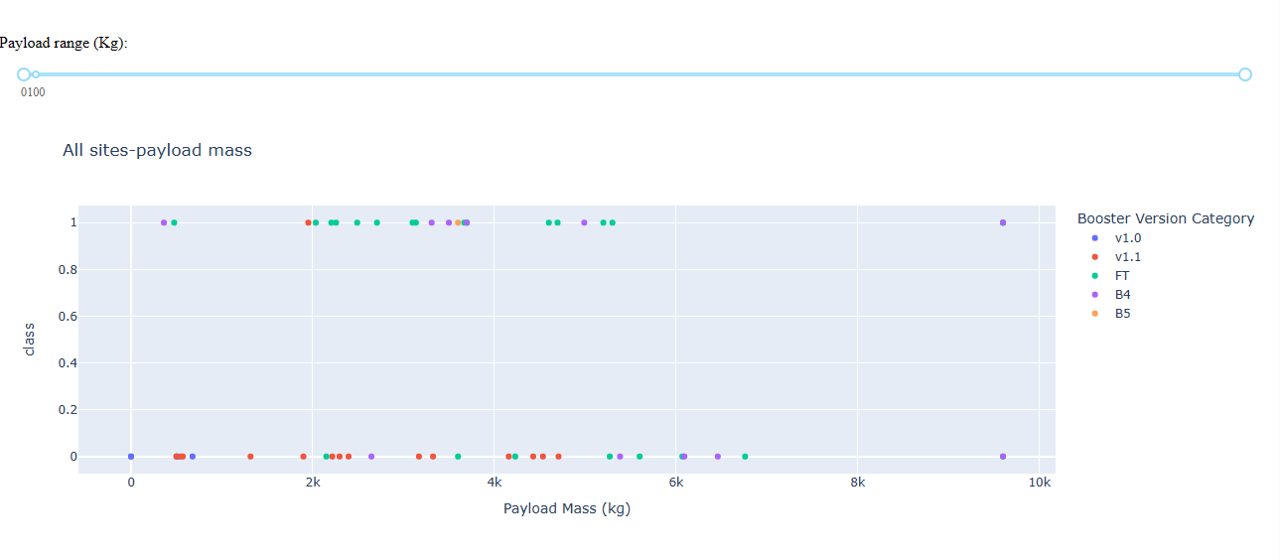
Payload vs. Outcome
Shows the relationship between payload and outcome in the range provided by the range slider

Slide 41

Section 5

Slide 42
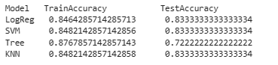
Classification Accuracy
From the results it is a 3 way tie between Log Reg, SVM, and KNN, so we will use Log Reg

Slide 43

Confusion Matrix
This is the confusion matrix for the log regression it show the false positive, false negative, true positive and true negative counts

Slide 44
Conclusions

Slide 45
Appendix
Include any relevant assets like Python code snippets, SQL queries, charts, Notebook outputs, or data sets that you may have created during this project

Slide 46


